Slide 1

"Welcome to my presentation"
By :- Yash Raj(24k-0737)

Slide 2
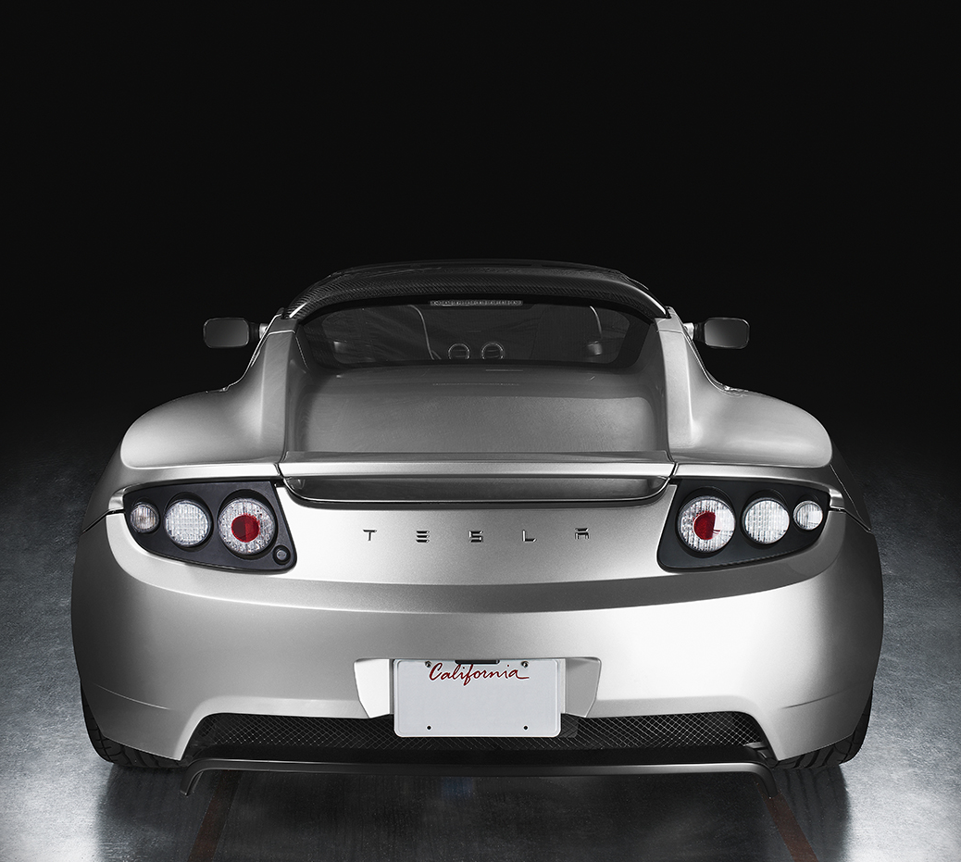
" 2025 Tesla roadster"
An all-electric vehicle, the Tesla Roadster is the quickest car in the world, with record-setting acceleration, range and performance

Slide 3

"AI IS THE FUTURE"
Elon Musk Predicts “None of Us Will Have a Job” If AI Takes Over.

